Slide 1
DCVMN workshop

Slide 2
mRNA Regulatory and production technology
Day1: Sep 6
CET | SG time | Topics | Speaker | Duration (include Q&A)
08:30 | 14:30 | Call in (30mins before live) Zoom Link | All
09:00 | 15:00 | Start Live! Introduction + house rule | MC - DCVMN | 5mins
09:05 | 15:05 | Key quality considerations on mRNA within an Integrated mRNA CDMO offering No Poll | Julian Mochayedi | 45+10 (55mins)
10.00 | 16.00 | Regulatory Points to be considered for mRNA vaccine Poll? | Jeong-Hoon Lee | 45+10 (55mins)
10:55 | 15:55 | Break 5mins | MC
11.00-11:55 | 17.00-17:55 | mRNA Facility Qualifications & Key Watchouts Poll? | Larry Zhu | 45+10 (55mins)
11.55-12.00 | 17:55-18:00 | Closing 5mins | MC
Panel list:
Julian Mochayedi julian.mochayedi@merckgroup.com; Jeong-Hoon Lee jeong-hoon.lee@merckgroup.com; Larry Zhu larry.zhu@merckgroup.com; and Josephine Cheng josephine.cheng@merckgroup.com; Nantanut Prateepsritorn nantanut.prateepsritorn@merckgroup.com

Slide 3
Day2: Sep 7
Merck Workshop - Process development. Facility design and Market Trends
CET | SG time | Topics | Speaker | Durations
08:30 | 14:30 | Call in (30mins before live) Zoom Link | All
09:00 | 15:00 | Start Live! Introduction + house rule | MC - DCVMN | 5mins
09.05-09.50 | 15.05-15.50 | Process Development of Virus-Like Particle (VLP) Technology: A VLP COVID-19 Vaccine Case Study – Poll before/at the end? | Naomi and Matthew (pre-record, and take live Q&A) | 45mins VDO
09.50-10.35 | 15.50-16.35 | Facility Design and investment market overview Poll? | Ina Bhartia & Steve Maina | 45mins
 |  | Break |  | 5 mins
10.40-11.25 | 16.40-17.25 | Future vaccine manufacturing outlook and cost comparison between traditional and novel vaccines Poll? | Josephine | 45mins
11.25-12.00 | 17.25-18.00 | Q&A Session Note: Naomi & Matthew to call in at 17.15SGT Time or 05.15 am NY time | All | 30mins + Closing 5mins
Panel list:
Naomi Baer naomi.baer@milliporesigma.com; Ina Bhartia ina.bhartia@merckgroup.com; Steve Maina steve.maina@merckgroup.com; Matthew Resch mresch@technovax.com and Josephine Cheng josephine.cheng@merckgroup.com; Nantanut Prateepsritorn nantanut.prateepsritorn@merckgroup.com

Slide 4
Insert this slide when you have poll question

Slide 5
DCVMN Speaker bio
Speaker profile

Slide 6
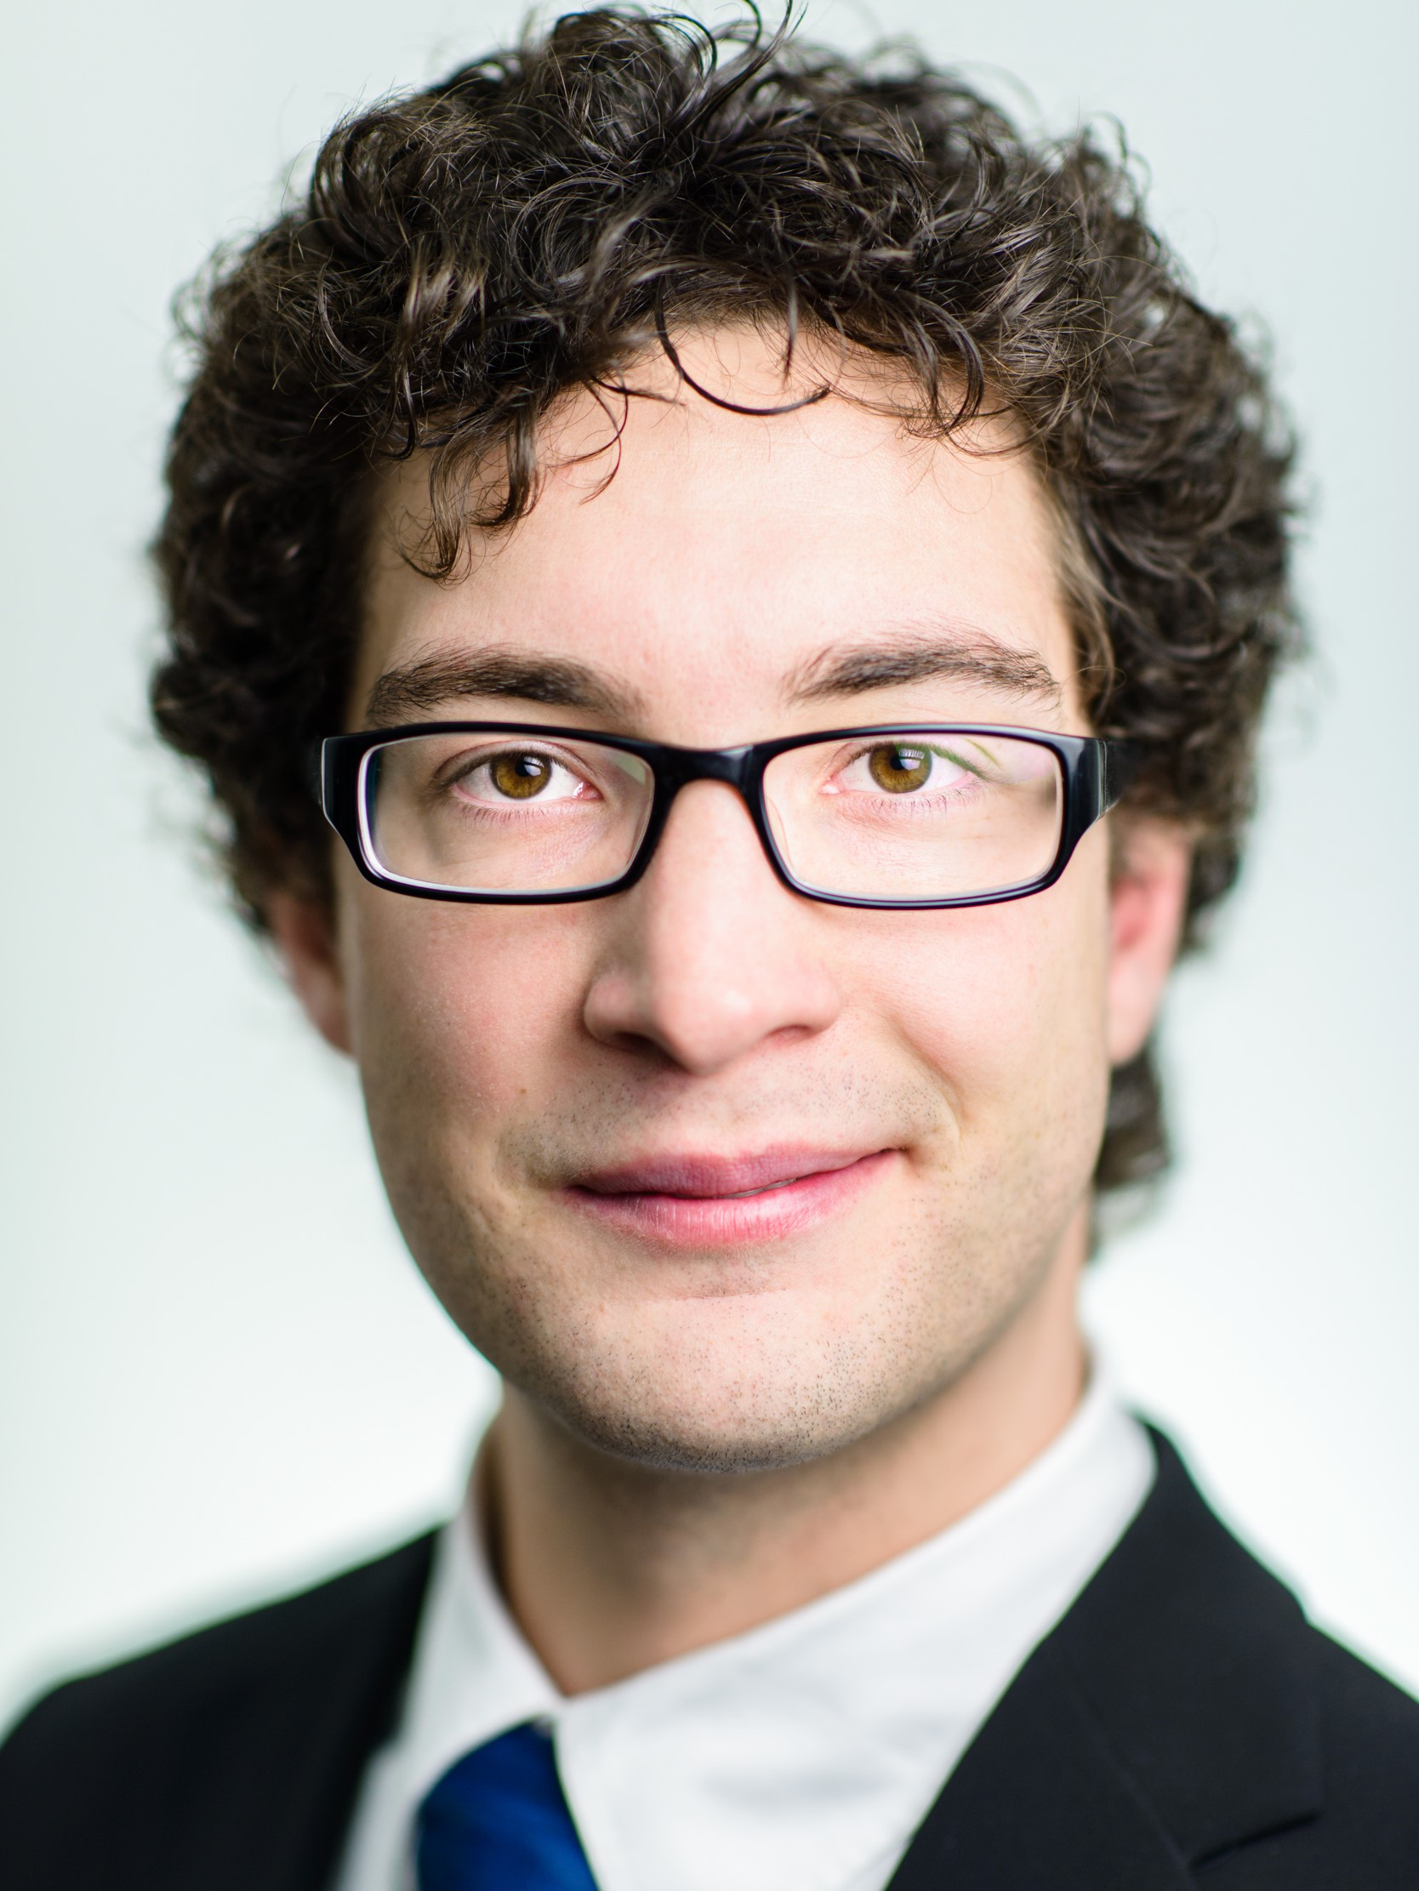
Sep6
Topic1: Key quality considerations on mRNA within an Integrated mRNA CDMO offering
Julian is the strategic marketing manager for mRNA solutions and responsible for the strategy development and positioning of the mRNA CDMO offering based on the acquisition of AmpTec GmbH, a leading mRNA CDMO. Prior to joining Merck KGaA in Darmstadt, Germany, he gained experience in translational research with profound expertise in the areas of novel modalities and in vivo gene editing. Julian holds a M.Sc. in bioprocess development and a Ph.D. in translational immunology from Heidelberg University.
Dr. Julian Mochayedi
Strategic Marketing Manager for mRNA solutions
Life Science Services | Synthesis & ADC CDMO (SAC)

Slide 7
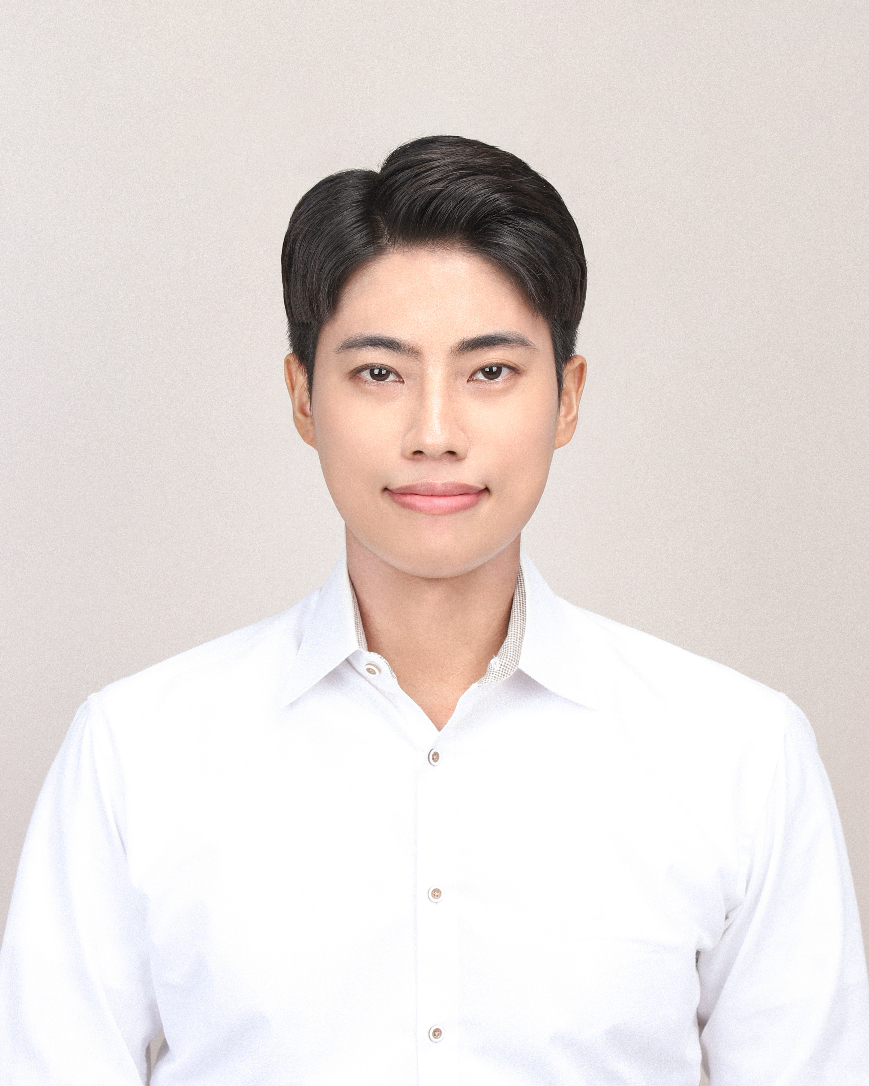
Topic2: Regulatory Points to be considered for mRNA vaccine
Sep6
Jeonghoon is a regulatory management specialist in Merck Korea and responsible for customer training management, supporting market authorization of the customer and 3rd party distributor, and regulatory review for imported products (Raw material for pharmaceuticals, IVD, flavor and fragrance). Over his 8 years of pharmaceutical industry experience, he has taken wide range of responsibilities as a QA specialist.
Jeonghoon holds Bachelor degrees in Biology from Yonsei university, S. Korea.
Mr. Jeong-Hoon Lee
Regulatory Management Specialist

Slide 8
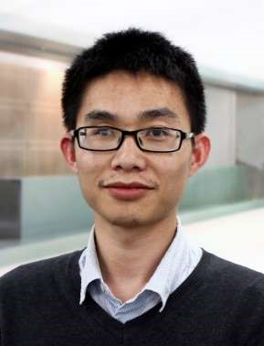
Larry Zhu
Sep6
Topic3: mRNA Facility Qualifications & Key Watchouts
Larry is a Senior Quality & Validation Consultant at Merck China Pharma Regulatory Advocacy & Consultancy Service. Larry’s background is Pharmaceutical Preparation, he has more than 12 years working experience in pharmaceutical industry, he provided validation service longtime for international pharmaceutical companies, such as Eli Lily and Roche. Larry is familiar with the oral solid dosage and biopharmaceutical manufacturing process, aseptic process simulation, design review of facilities and clean utilities, commissioning and qualification activities, validation practices, in pharmaceutical industries.
Mr. Larry Zhu
Senior Quality & Validation Consultant
China Pharma Regulatory Advocacy & Consultancy Service

Slide 9
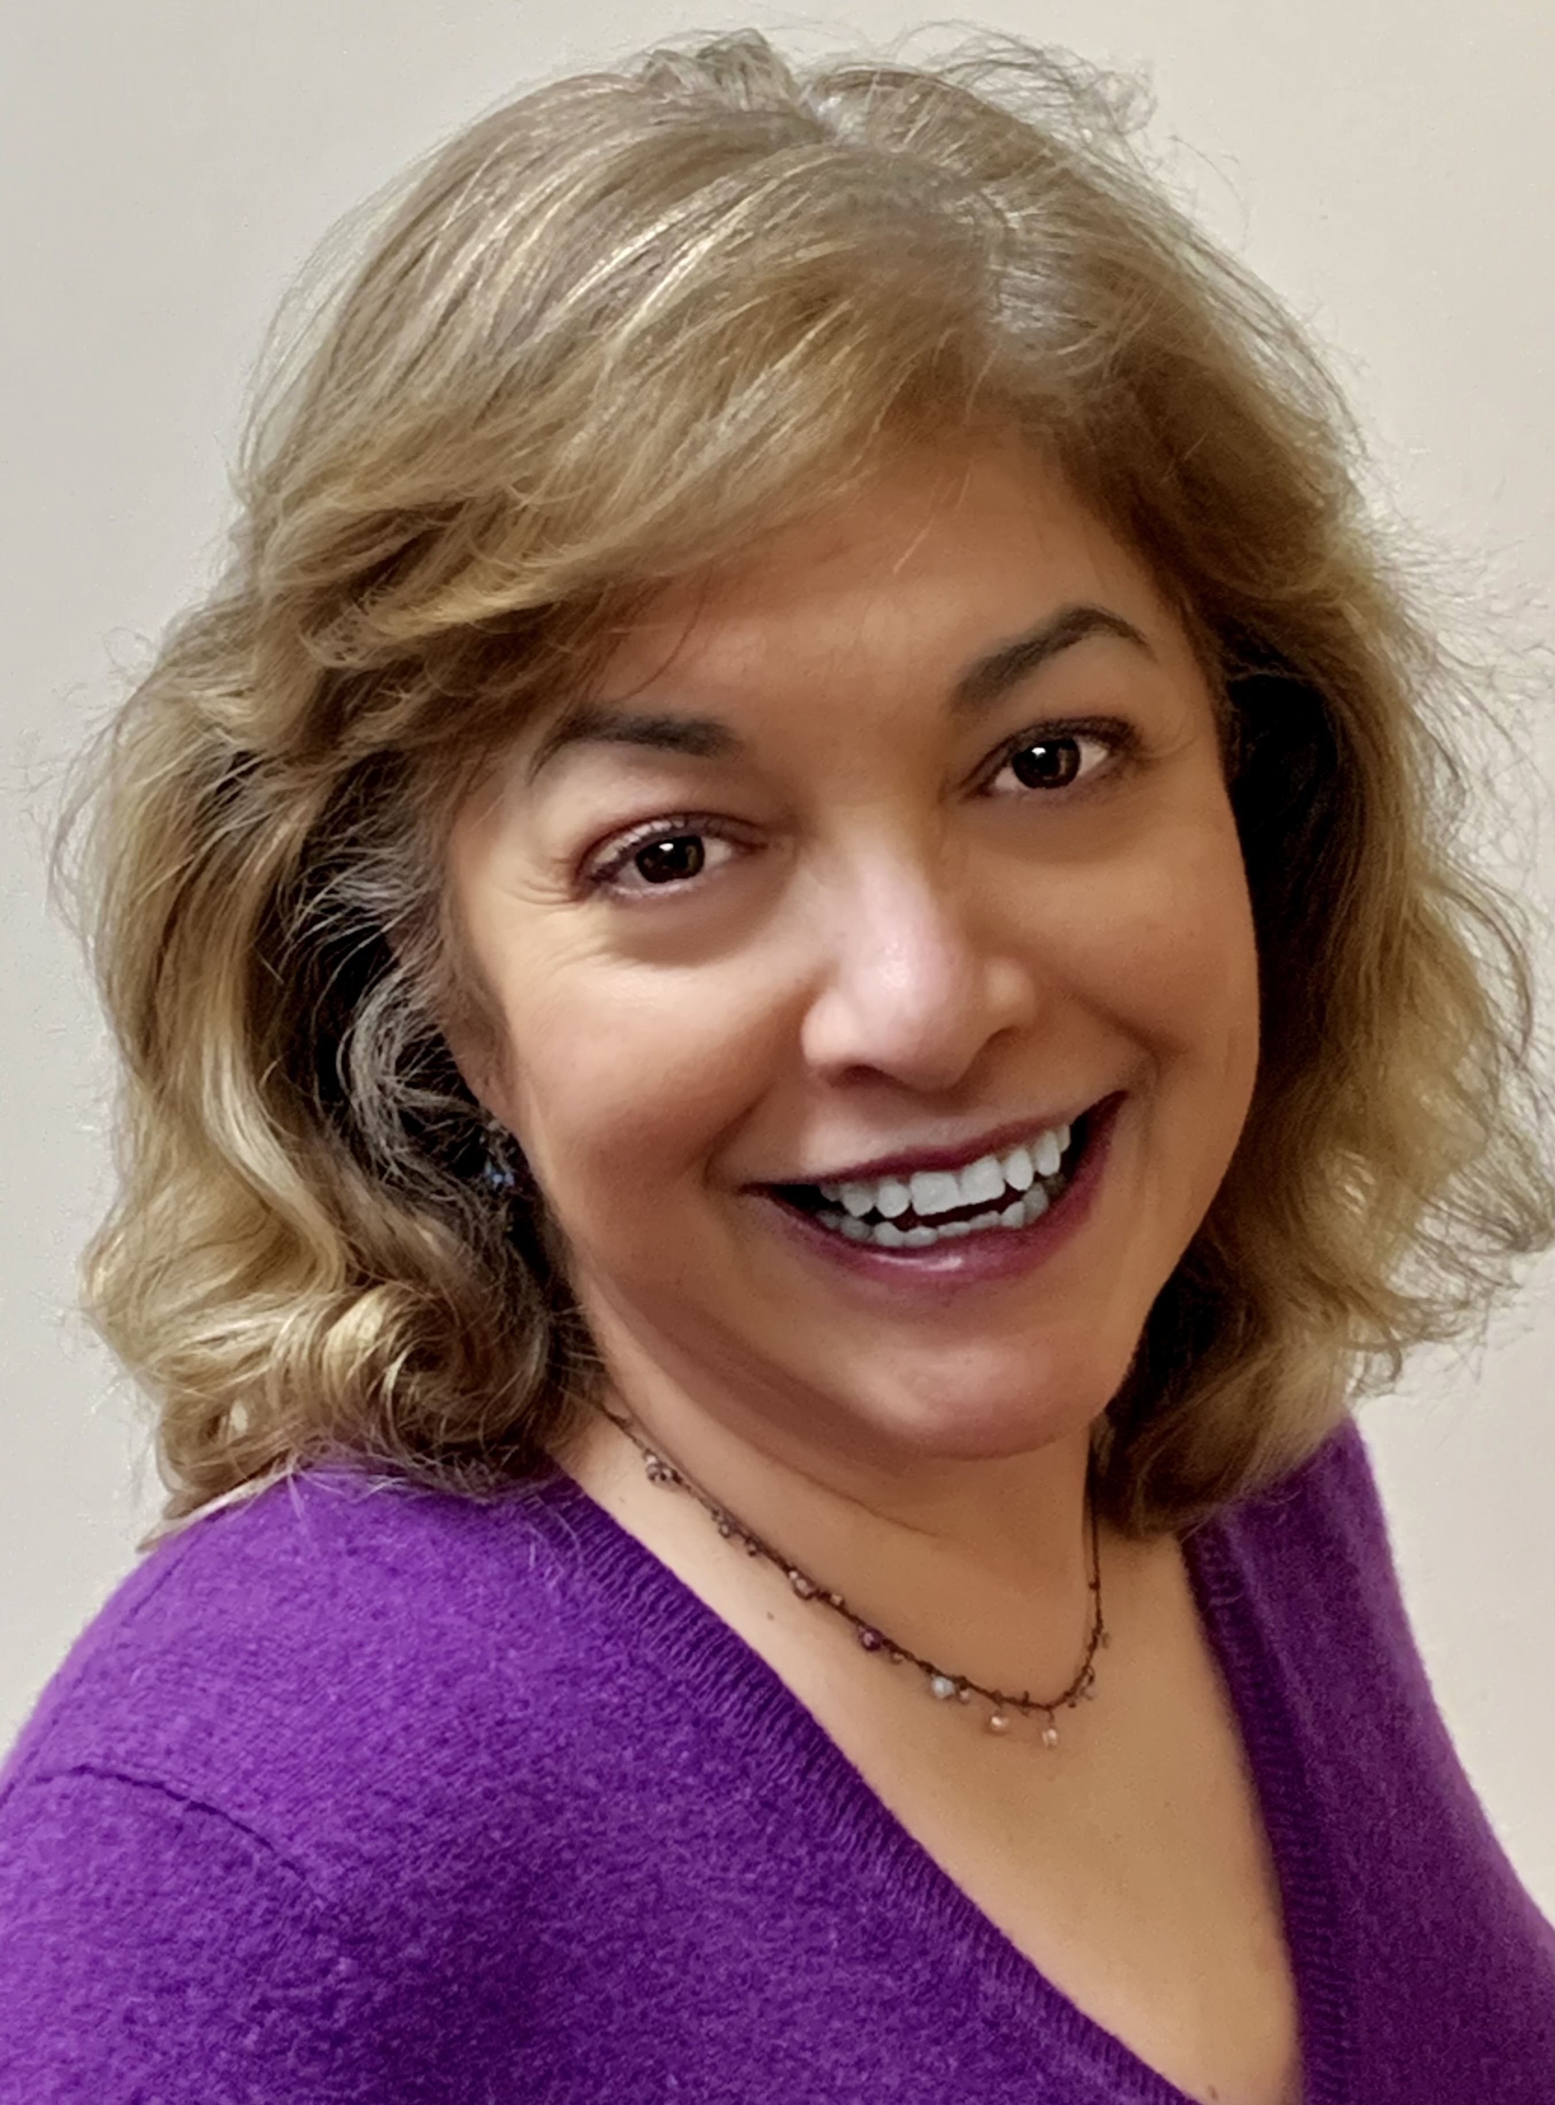
Topic1: Process Development of Virus-Like Particle (VLP) Technology: A VLP COVID-19 Vaccine Case Study (VDO)
Sep7
Naomi Pintel Baer is a highly regarded Business Development Consultant at MilliporeSigma where she supports early-stage biopharma companies developing scalable upstream and downstream processes for advancing biologics into the clinic. She has more than 30 years of experience in the industry, including in the areas of research, process development, and QC biomonitoring. She began her career at a molecular biologist at Dupont. She graduated with a BS degree in biology from the University of the Sciences in Philadelphia, PA.
Ms. Naomi Pintel Baer
Business Developing Consultant
Emerging Biotech
Bioprocessing Commercial
Mid-Atlantic, USA

Slide 10
Topic1: Process Development of Virus-Like Particle (VLP) Technology: A VLP COVID-19 Vaccine Case Study (VDO)
Sep7
Matthew Resch
Bachelors, Binghamton, NY University, 2019
Masters, Binghamton, NY University, 2020, studied the dispersion response of biofilms formed by pathogenic bacteria
Research Scientist at TechnoVax
  Adenoviruses and COVID-19 Vaccines
  Immunoassay
  Immunogenicity studies
  Animal studies
No image

Slide 11
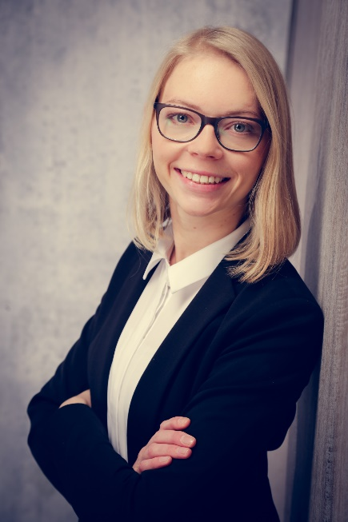
Topic2: Facility Design and investment market overview
Sep7
Ina is a Senior Strategy Manager for the Merck´s Life Science Services and external Consulting Services business. With a business chemistry and consulting background Ina is well equipped to solve both technical and business problems. Today Ina focuses on helping our customers build capabilities in biologics and novel modalities. Furthermore she is in charge of driving key strategic expansion projects. Being based in Singapore, she works mainly with customers in the APAC and middle-east region to build the bridge between a companies' vision, strategy and execution.
Ina Bhartia
Senior Strategy Manager
Life Science Services

Slide 12
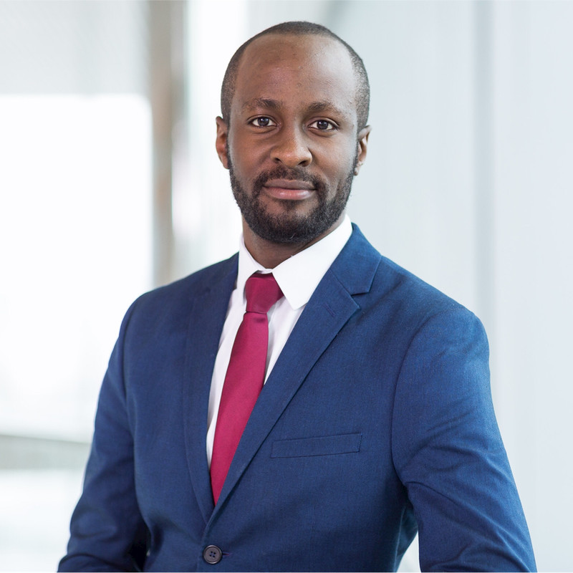
Sep7
Topic2: Facility Design and investment market overview
Steve recently joined the Merck’s Life Science Services team as Director of Advisory Services. Steve has more than 10 years experience working with Merck Life Science in global strategy development & portfolio management as well as commercial sales and marketing in the fast-paced developing markets of Middle East and Africa for Merck Life Science. Steve holds an executive MBA degree from Essec (France) and Mannheim (Germany) Business schools and a degree in Economics (Hons.) from Kenyatta University in Kenya.
Steve Maina
Director of Advisory Services, Life Science Services

Slide 13
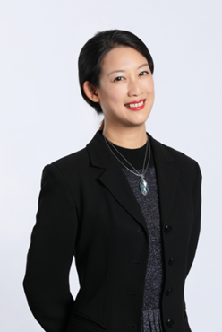
Topic 3: Future vaccine manufacturing outlook and cost comparison between traditional and novel vaccines
Sep7
Josephine is a Senior Consultant for Traditional Modalities, Bioprocessing Strategy at Merck, focusing on Vaccine in APAC, where she stays on top of the market trends, fosters customer collaborations, supports innovation, leads marketing initiatives, and transforms insights into sustainable business strategies. Over 14 years of international biopharma experience, Josephine has accumulated practical market-specific process knowledge from various positions ranging from R&D, Application, Training, Marketing, and Strategy. Josephine obtained both Bachelor's and Master's degrees in Bio-resources & Agriculture from the National Taiwan University, focusing on protein & molecular science.
Ms. Josephine Cheng
Senior Consultant
Traditional Modalities Bioprocessing Strategy APAC

