Slide 1
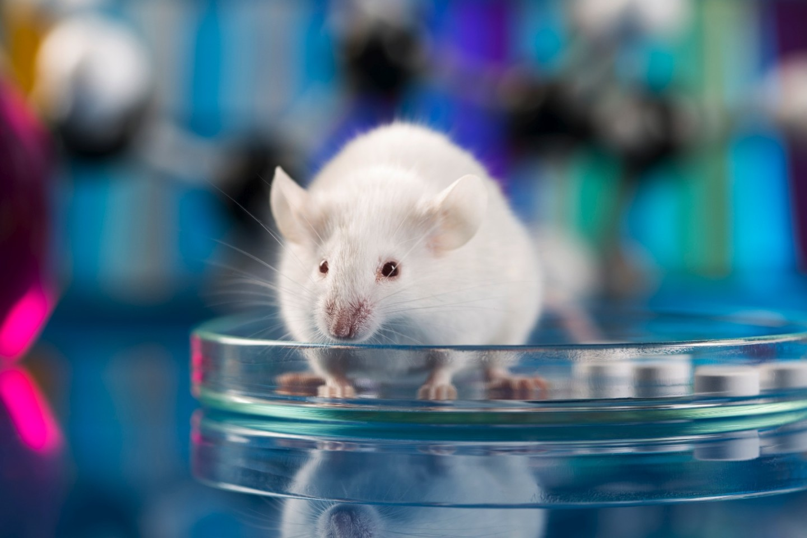
3Rs Update
DCVMN Regulatory Working Group
June 18th, 2021

Slide 2
3Rs WG - Share case studies on successful 3Rs implementation
Examples for Safety Tests
Abnormal Toxicity Test,
deletion of Specific Toxicity Test for Tetanus,
deletion of the pertussis irreversibility test and replacement of HIST with CHO-cell assays
Next Generation Sequencing (adventitious viruses/agents)
Examples for Potency Tests
Serological assays
Single dilution
SRID, RIA, etc.
Antigen quantification
In vitro relative potency test

Slide 3
3Rs WG and the PSPT wP Project
17 month Project sponsored by NIIMBL (started Sep 1, 2020). Consortium of 11 laboratories (3 NLCs, 7 DCVMN members, 1 manufacturer), 1 Research/service Provider
International in-house assessment of the PSPT in mice to replace the intracerebral-challenge Mouse Protection Test (MPT) for whole-cell Pertussis (wP)
Monthly technical workshops. Ad hoc Steering Group meetings.
Update @ Q2:
Coating antigen produced & characterized
Shipment ongoing (delays due to COVID19): 7 completed, 2 in transit, 1 pending MTA signature
DCVMN Data collection platform created and logins shared with labs
2 labs has started the testing phase
Exploring options for future management of the remaining coating antigen:1800 vials to be equally distributed
DCVMN donation to a Centralized distributor (e. g., NIBSC) but maintenance and shipment costs to be foreseen for user labs
Donation to all wP manufacturers and NCLs of vials (ca. 30 labs globally, tbc) shipment covered by grant
Donation to an interested research lab (in case of negative outcomes from the study)

Slide 4
Updates on 3Rs initiatives & opportunities
Abnormal Toxicity Test
Animal Free Safety Assessment Collaboration + EFPIA plans half a day discussion with industry and regulatory stakeholders to speed up deletion of the test– October 14th, 2021 at 12:30 CET.
Invitation to DCVMN and all its members will come soon.
Rabies – replacement of NIH with ELISA
EDQM/EPAA BSP148 phase 2 started – protocol distributed, vaccines samples distribution

Slide 5
Updates on 3Rs initiatives & opportunities
Polio Vaccines – NGS to replace MAPRECT+Monkey NVT
PATH is looking for interested manufacturers to join FDA/NIBSC phase 2 international collaborative study. If interested contact Kutub Mahmood - kmahmood@path.org
HSI Working Group “Accelerating 3Rs methods in vaccine testing in China”
Collaboration with Tsinghua University in regulatory requirements comparison
Engagement of more industry and regulatory stakeholders. Interested?

Slide 6
Updates on 3Rs initiatives & opportunities
NC3Rs: Reviewing animal use requirements in WHO biologics guidelines – opportunities for the 3Rs – https://nc3rs.org.uk/review-animal-use-requirements-who-biologics-guidelines
Review of the TRS and General Recommendations work almost complete.
Aim: propose new language introducing 3Rs approaches among the testing requirements.
Survey to manufacturers and regulators will be shared soon.
11th World Congress On Alternatives And Animal Use In The Life Sciences
23 August - 2 September 2021 | Virtual Congress - https://www.wc11maastricht.org/

Slide 7
Key 3Rs publications
Characterisation of tetanus monoclonal antibodies as a first step towards the development of an in vitro vaccine potency immunoassay. https://doi.org/10.1016/j.biologicals.2021.04.002
Characterisation of diphtheria monoclonal antibodies as a first step towards the development of an in vitro vaccine potency immunoassay. https://doi.org/10.1016/j.biologicals.2020.12.002
Variability of in vivo potency tests of Diphtheria, Tetanus and acellular Pertussis (DTaP) vaccines. https://doi.org/10.1016/j.vaccine.2021.03.078

